Slide 1

Take Me Home Tonight
Rachel Blacker, Shawn Minarik,
Christopher Renus and David Sparkman

Slide 2
Our Goal
To provide a way for students to find rides to and from school easily, even if they don’t have a car or know someone who has one

Slide 3
Our Audience
Students, Faculty, Staff within the RPI community
Students who may not have cars on campus
Anyone at RPI in need of transportation
Eventually branching out to other campuses

Slide 4
Wireframes

Slide 5
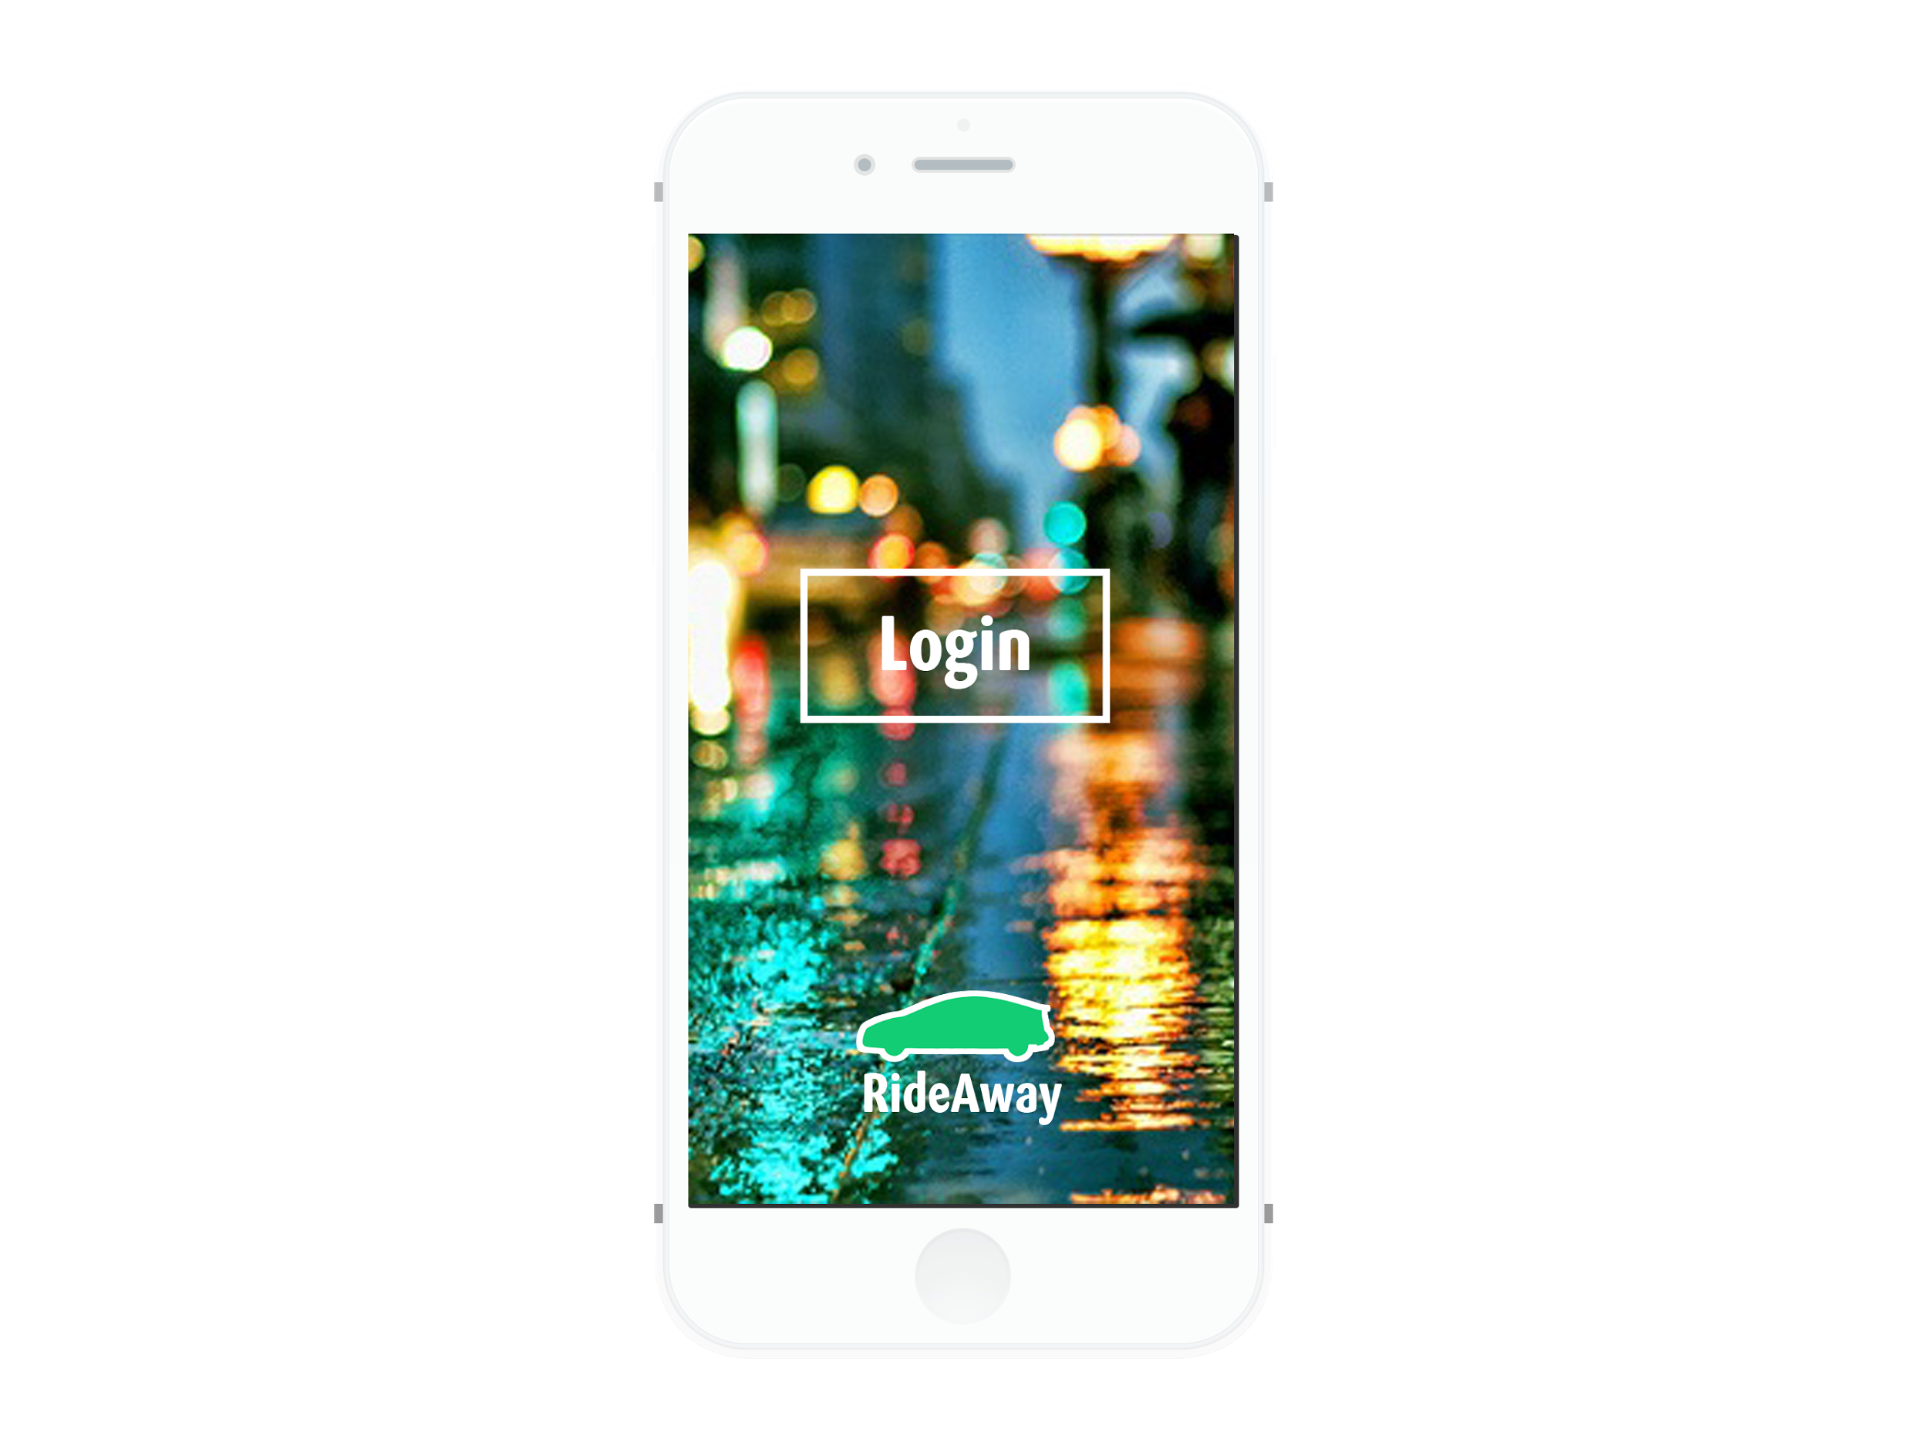

Slide 6
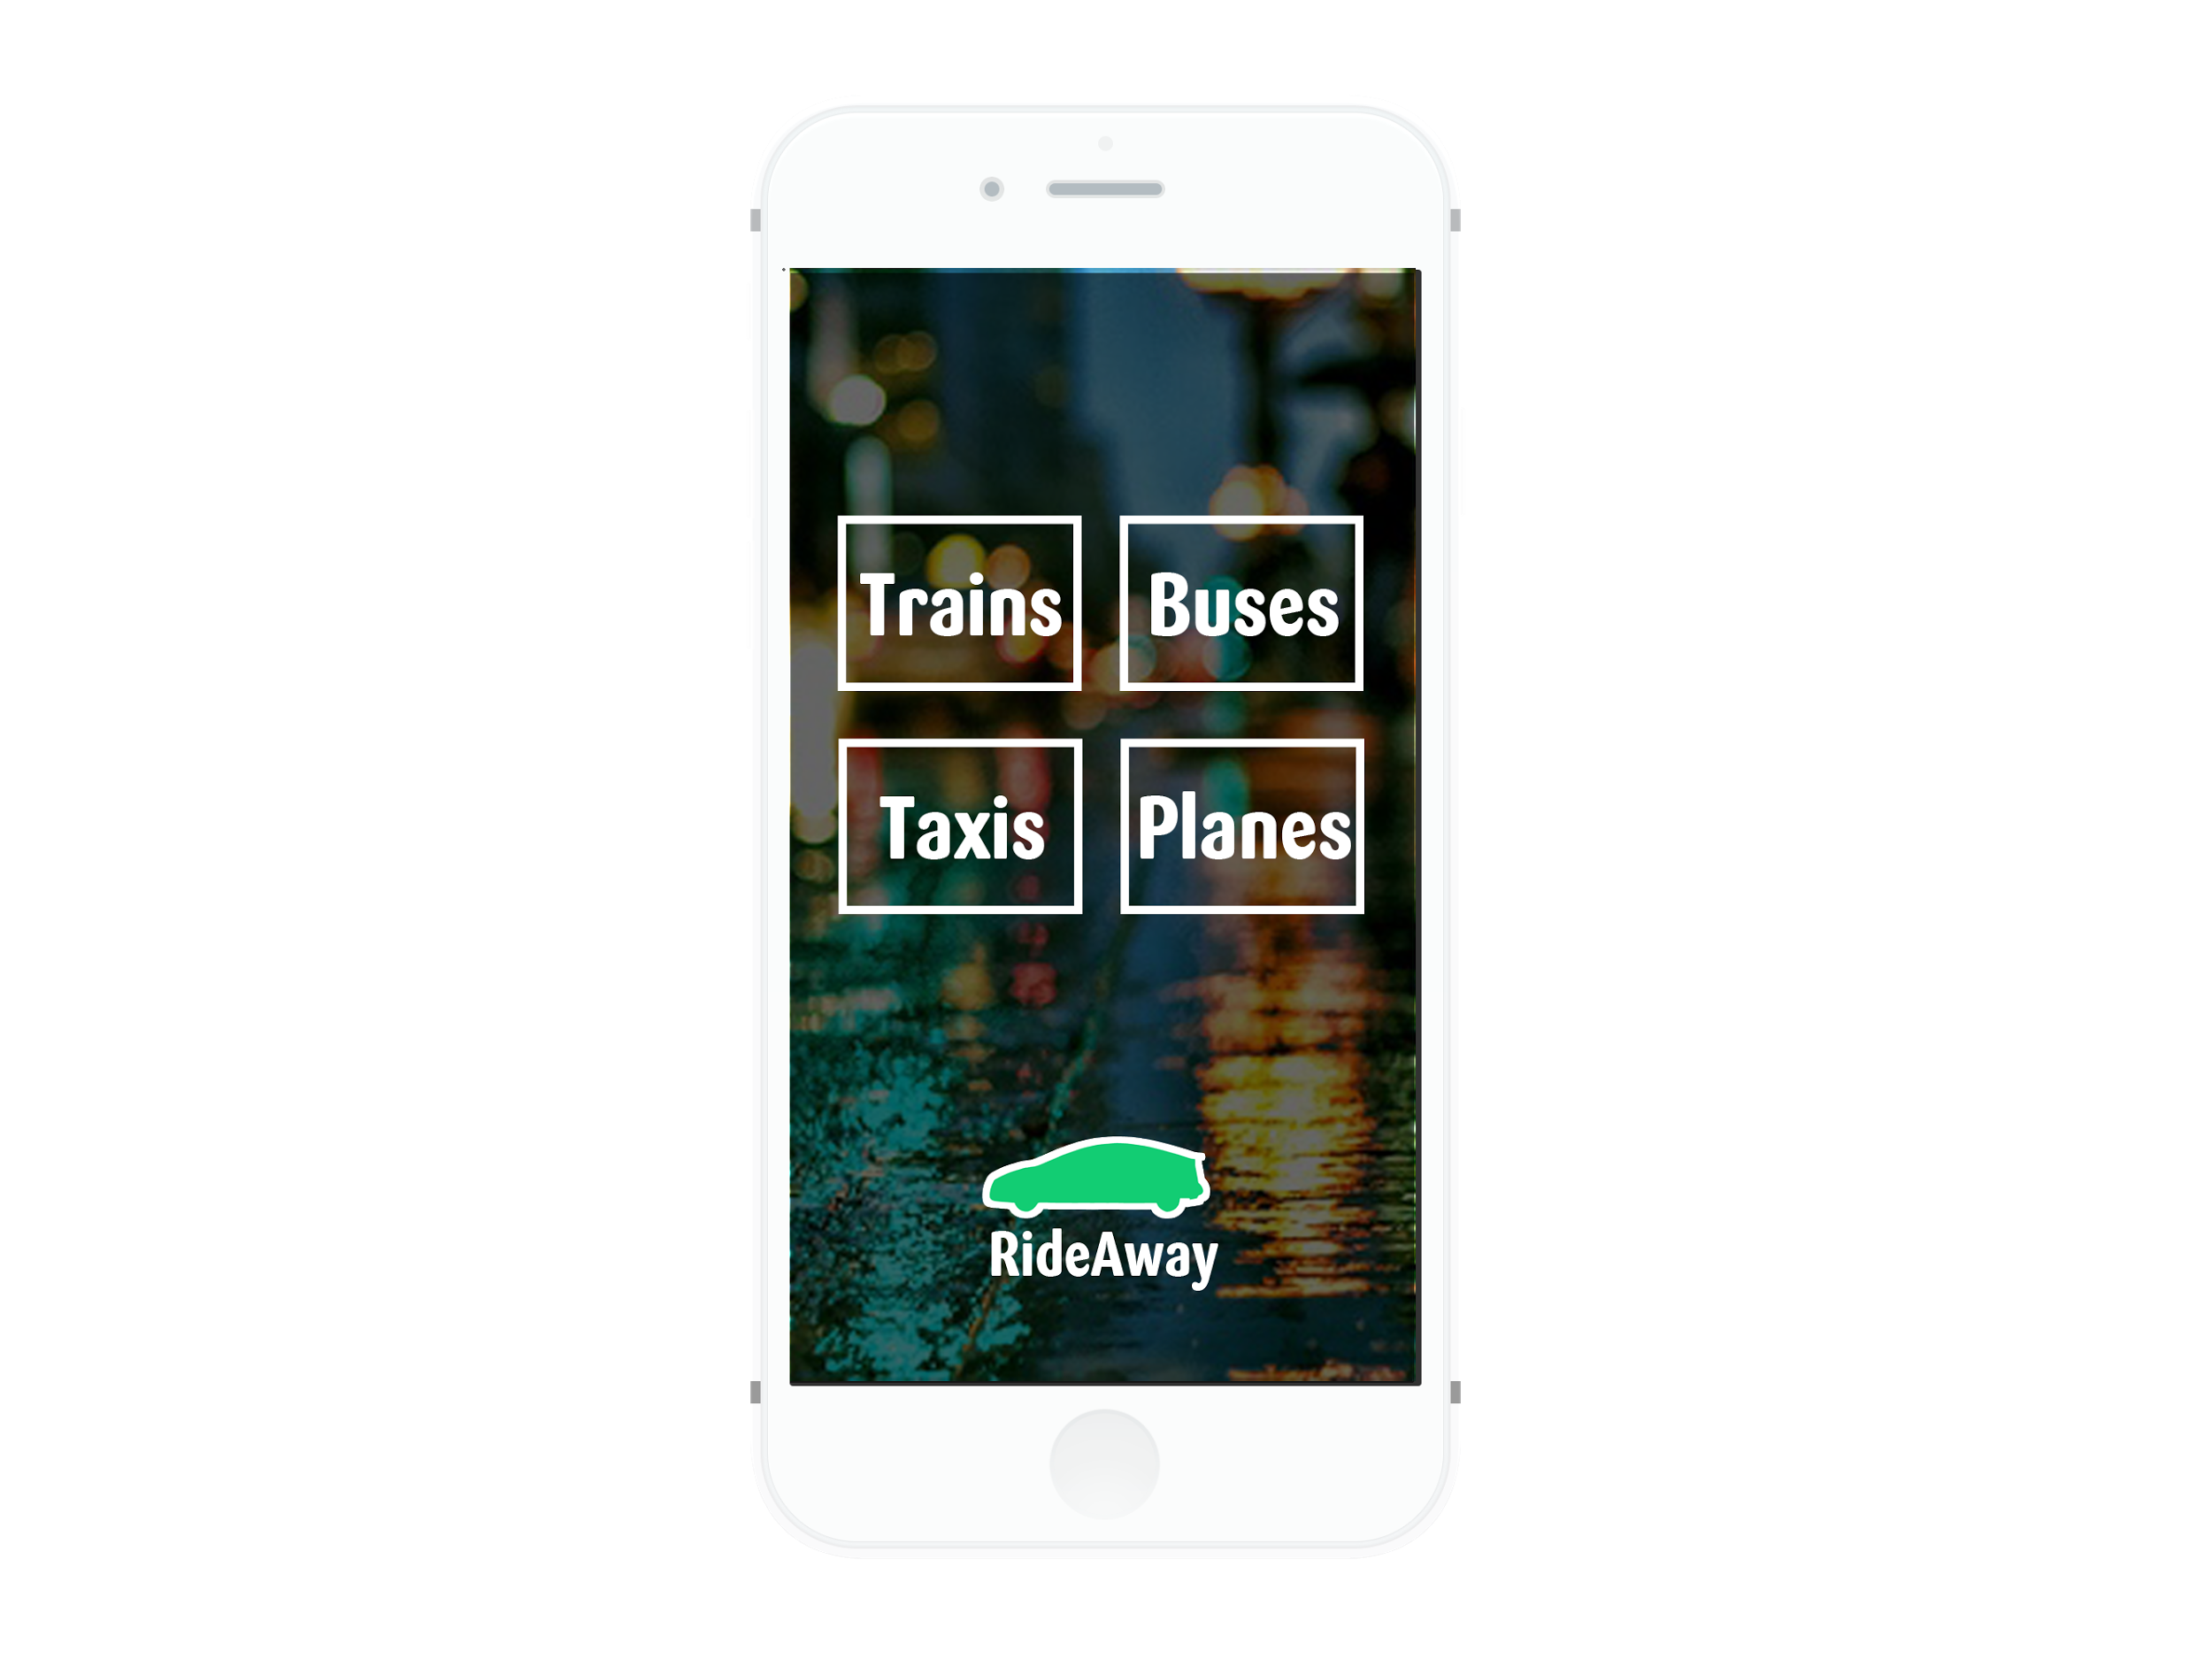

Slide 7
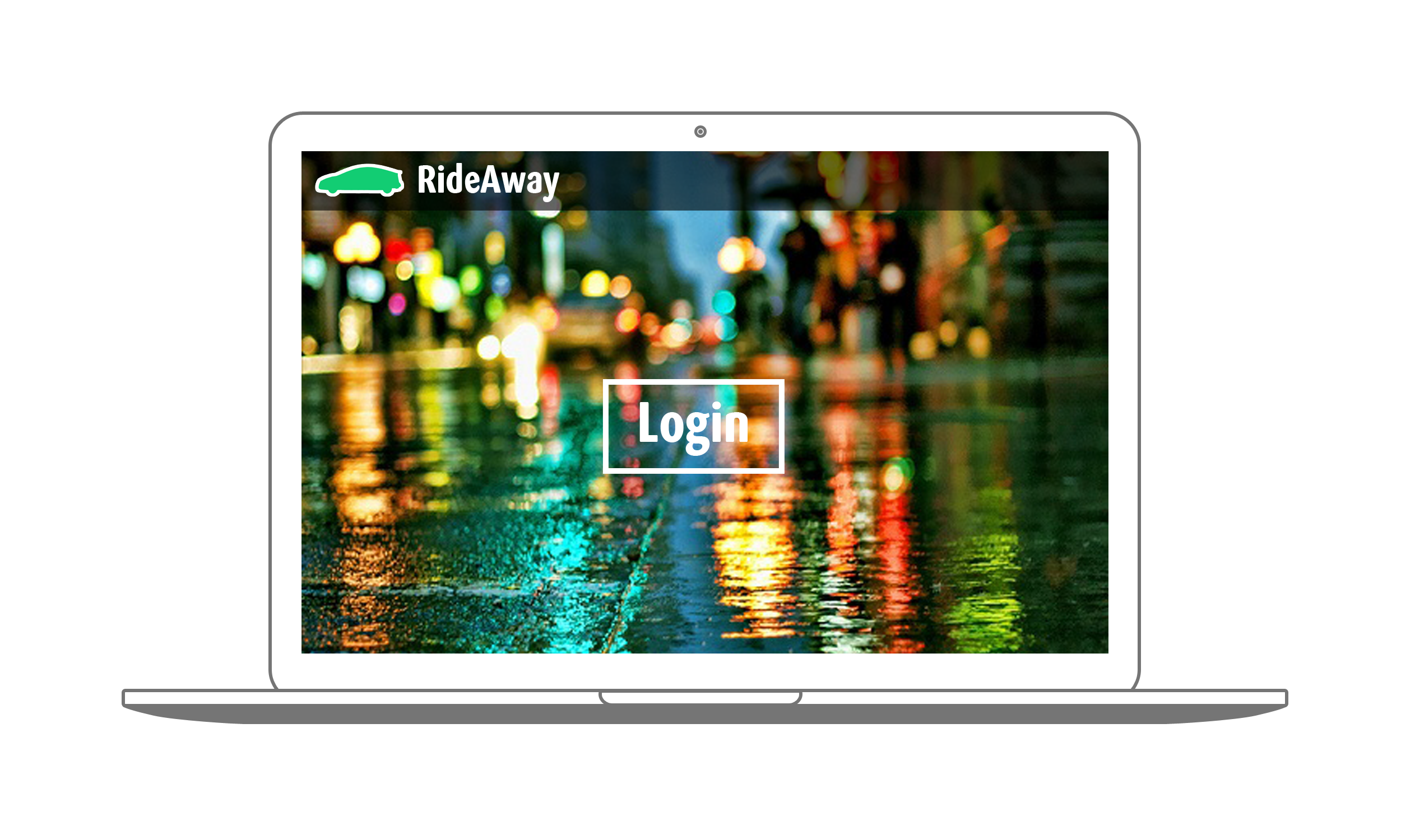

Slide 8
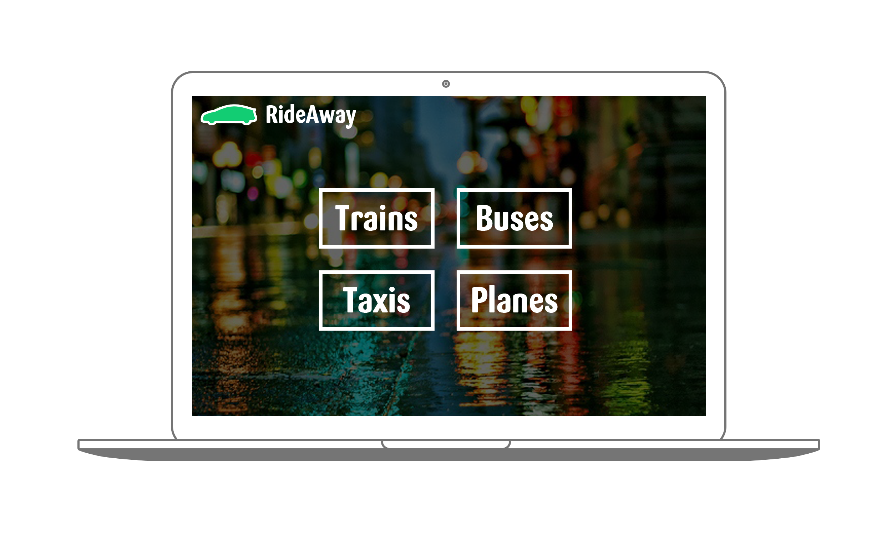

Slide 9




Front End Technologies

Slide 10




Back End Technologies

Slide 11
Integrated Services
CAS for authentication
Google Maps
Amtrak API
Greyhound API
CDTA Information
Taxi information

Slide 12
Prototype Demo

Slide 13
Future Plans
Pending / Attending Button
Connect DB to website
Connect Public Transit APIs
Settings Page / User Sign Up
Access Control
Testing Data

Slide 14
Questions?

Slide 15
Take Me Home Tonight

